Slide 1
Touch For Food March 5 Meeting
CloudNine

Slide 2
Agenda
Announcements
Scrum updates
Priorities
Presentation
Individual Meetings
Questions?

Slide 3
Announcements
Handing in docs tomorrow

Slide 4
Scrum updates
5 minutes

Slide 5
Priorities
Handing in docs
Finishing functionality
Improving code quality (patterns, best practices, etc.)

Slide 6
Presentation
TFF running on two servers
Server will have remote access (to test next week)
Trying to get food budget (100-150$)
Making a video to show tapping in and ordering process
Two posters?
Pat, what booth decorations did you have in mind?

Slide 7
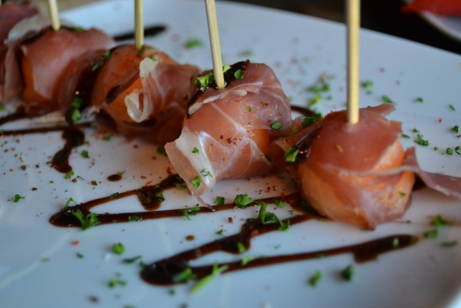

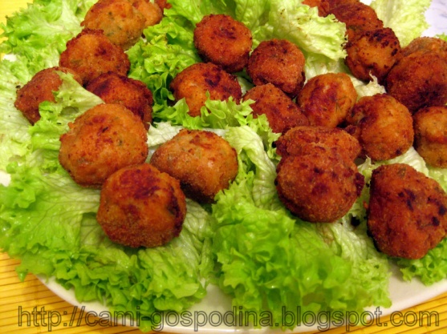
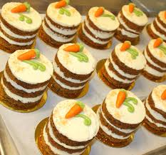
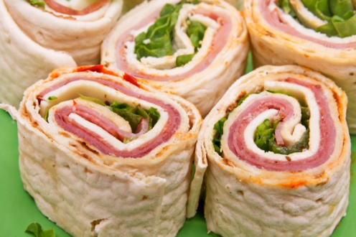
Presentation

Slide 8
Individual Meetings

Slide 9
Questions?

